Slide 1
Welcome to Psy 652 Lab! Module 6: Merging Datasets, Correlation, Partial Correlation, & Simple Linear Regression (SLR)

Slide 2
Objectives
A quick note on merging datasets (Via *_join() )
Correlations, Partial & Semi-partial correlations
R tutorial

Slide 3
Merging (Joining) datasets

Slide 4
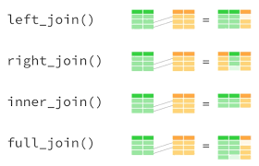
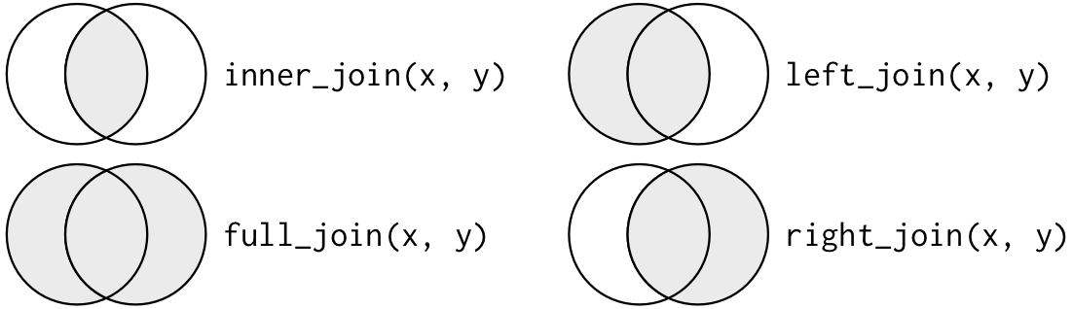
Joining datasets via tidyverse’s _join()
General format:
*_join(left, right, by = “id”)
* = fill in left, right, inner, or full
left = left dataset
right = right dataset
By = “id” = The id to match on (change to variable you want to match on)
left_join() keeps all id’s on the left dataset
right_join() keeps all id’s on the right dataset
inner_join keeps only id’s present on both dataset
full_join keeps every id in both datasets

Slide 5
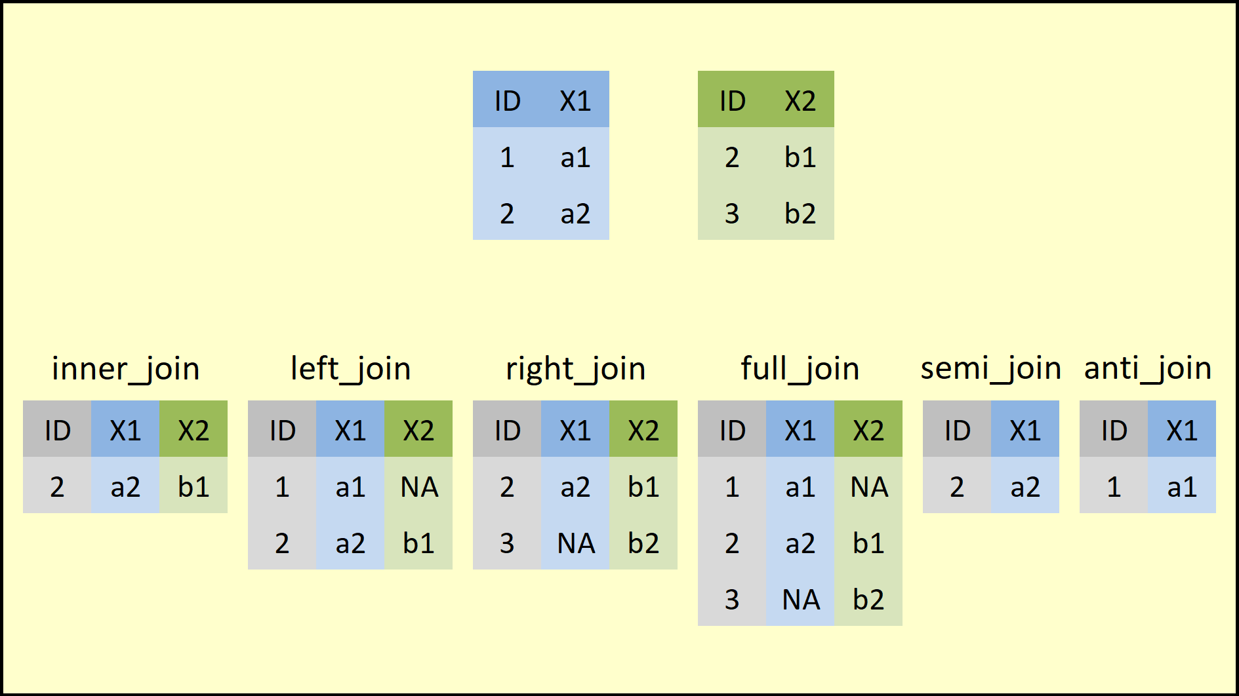

Slide 6
Partial and semi-partial correlations

Slide 7
Partial and semi-partial correlations
Partial and semipartial correlations are easily confused!
Both are correlations that control for a 3rd variable (a confounder)
However, the way they control for the variables is different
Partial correlation = Removes part the effect of a confounder from both the predictor AND the outcome
Semi-partial correlation = removes the effect of a confounder from ONLY the predictor variable

Slide 8
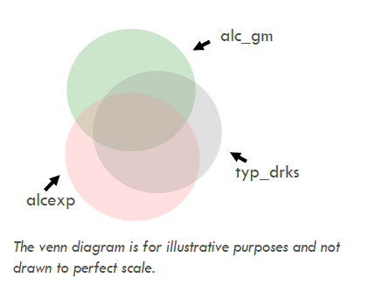
Partial and semi-partial correlations
Outcome
Confounder
Predictor
Predictor
*Thanks to Kim Henry for these visuals*

Slide 9
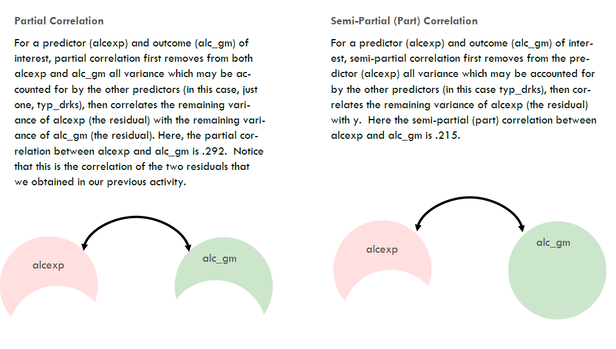
*Thanks to Kim Henry for these visuals*

Slide 10
Let’s code!

